Slide 1
Product Development

Slide 2
Objectives {what do I want to tell you}
Give an example how 1 company handled design {development} of a consumer product.
Explain the concepts behind the product methodology.
Give examples how these might be applied to FIRST robotics competition.

Slide 3
Background
Product Engineer at Ford Motor Company for ~30 years.
Never worked in Manufacturing Engineering, at Ford.
Worked in several functional areas;
Vehicle Safety
Integration
Vehicle Dynamics, Noise Vibration and Harshness
Chassis Engineering
Worked exclusively in simulation and test development
It should be noted that automotive development is a highly mature industry ⇒ design alternatives are small compared to emerging technologies

Slide 4
Background: Ford Divisions
Body
Exhaust
NVH
Powertrain
Durability
Chassis
Safety
Fuel Systems
Ergonomics
Powertrain
Systems
Vehicle Dynamics
Electrical
Product Development
Manufacturing
Engineering
Plants
Marketing
Finance
Customer Service

Slide 5
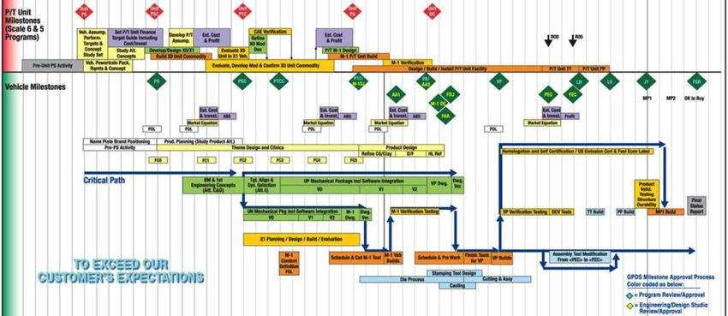
Program Development Timing
PS | Program Start | PSC | Program Strategy Confirmed | PTC | Program Target Compatibility
PA | Program Approval | FDJ | Final Design Judgement | CP | Confirmation Prototype
PEC | Preliminary Eng Completion | LR | Launch Readiness | LS | Launch Signoff
J1 | Job 1
Target development, design development, design verification, program timing

Slide 6
Target Cascade and Verification
PS
PSC
PTC
PA
FDJ
CP
LR
LS
J1
Vehicle
Targets
Vehicle
Verification
Zero to 60
System
Targets
Engine Torque
{Dyno Test}
System
Verification
Target Cascade
Target Verification
Component
Targets
½ Shaft
Strength
Component
Verification
Build Phase

Slide 7
Design Direction and Prototypes
PS
PSC
PTC
PA
FDJ
CP
LR
LS
J1
Target Cascade
Design
Verify
Production
Prove Out
Design Alternatives
Mule
Prototypes
M1 Prototype
CP Prototype

Slide 8
Product Direction Letter
Pre-Program
A description of the vehicle product developed by the pre-program team. Should have a set of aligned targets.
Issued at <PS>
Contains;
Target customers
Product Attribute placement (NVH, vehicle dynamics, safety, fuel economy, package, styling, etc)
Concept Drawings
Overall size, weight, Cost
Variations (base vehicle, luxury version, performance versions)
Countries sold
Plants to manufacture
Volume manufactured in future years
Future vehicles to be developed off of this design

Slide 9
FIRST Robotics Product Direction Letter
What strategy will the team take to succeed
What is the maximum score possible (SC_{max}).
What should our robot be able to score to be successful (SC_{wc}).
What scoring methods should we pursue to reach our robots score target SC_{wc}=SC_{c}+SC_{an}+SC_{ag}+SC_{ca}+SC_{aa}
What makes our robot perform well on a weak team
What make our robot perform well on a strong team
Coral Ground intake to minimize defense bots and travel time.
Fast to design, coral only bot that will allow program the most time to optimize reef scoring.
Eg. Do everything Bot, Coral Scoring Machine, Defense Bot
Game requirements
Weight
Package
Number of motors
Schedule of features to implement (climber last)
Preliminary timing plan
Concepts to pursue
Boom type arm vs elevator
Chain drive, belt drive, string drive
Ground intake vs hopper

Slide 10
FIRST Robotics Product Direction Letter
Component Preliminary Targets
Package Space
Number of motors
Weight
Attachment strategy
..
Preliminary
Package Space
Elevator
Hopper
Chassis
Climb

